Slide 1


PNEUMOTHORAX
استاد راهنما:استاد جوان
تهیه کننده مرجان زمانی

Slide 2
PNEUMOTHORAX
Pneumothorax occurs when the parietal or visceral pleura is perforated, exposing the pleural space to atmospheric pressure, which leads to the collapse of the lung or a part of it.

Slide 3

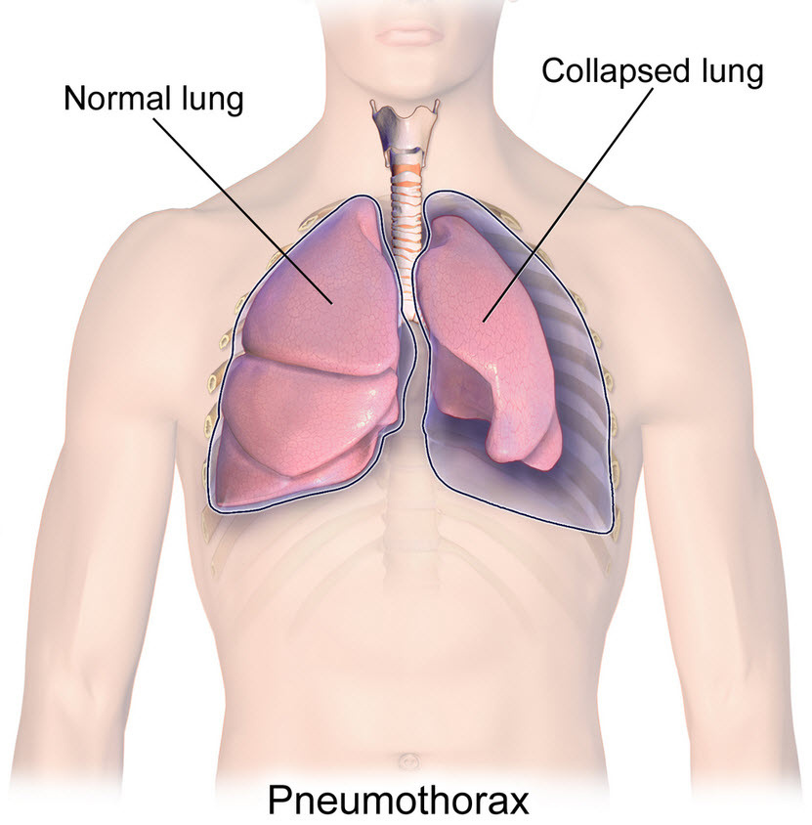
  Clinical manifestations:
Respiratory distress
Shortness of breath (dyspnea)
Use of accessory respiratory muscles
Hypoxemia and central cyanosis
Tracheal deviation
Hyperresonant sound on percussion
Restlessness
Hypotension
Profuse sweating
Tachycardia

Slide 4

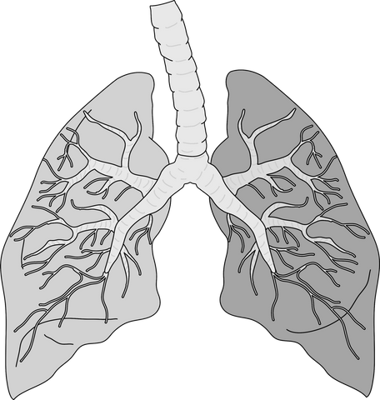
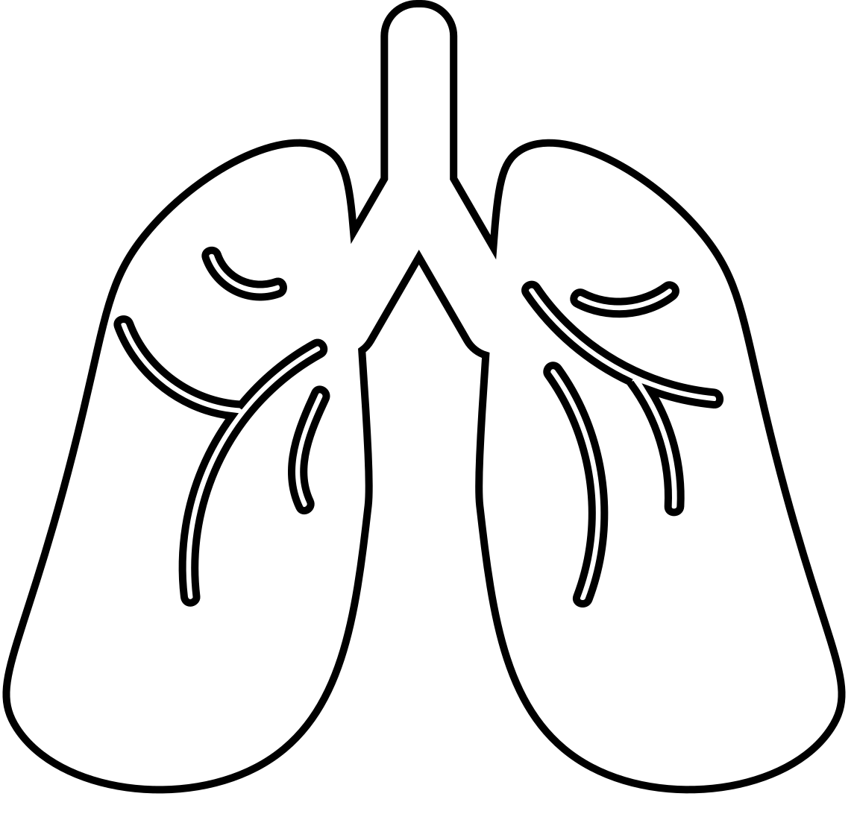

Simple pneumothorax:
Occurs due to the entry of air into the pleural space through a rupture or a bronchopleural fistula, often associated with conditions such as psoriasis.
Traumatic pneumothorax:
Results from penetrating or blunt injuries, diaphragmatic rupture, invasive procedures on the chest, or barotrauma. It may be accompanied by hemothorax.
Open pneumothorax:
A type of traumatic pneumothorax in which air enters and exits the chest cavity through an open wound during each breath, producing a sucking sound—hence the term “sucking chest wound.”
In this condition, not only does the lung collapse, but mediastinal structures shift toward the uninjured side during inspiration and to the opposite side during expiration, a phenomenon known as mediastinal flutter.
Tension pneumothorax:
Unlike open pneumothorax, with each inspiration air becomes trapped in the pleural space and cannot escape during expiration, creating a one-way valve mechanism.
This causes the heart and lungs to shift toward the uninjured side with each breath, leading to severe cardiorespiratory compromise.
TYPES OF PNEUMOTHORAX

Slide 5
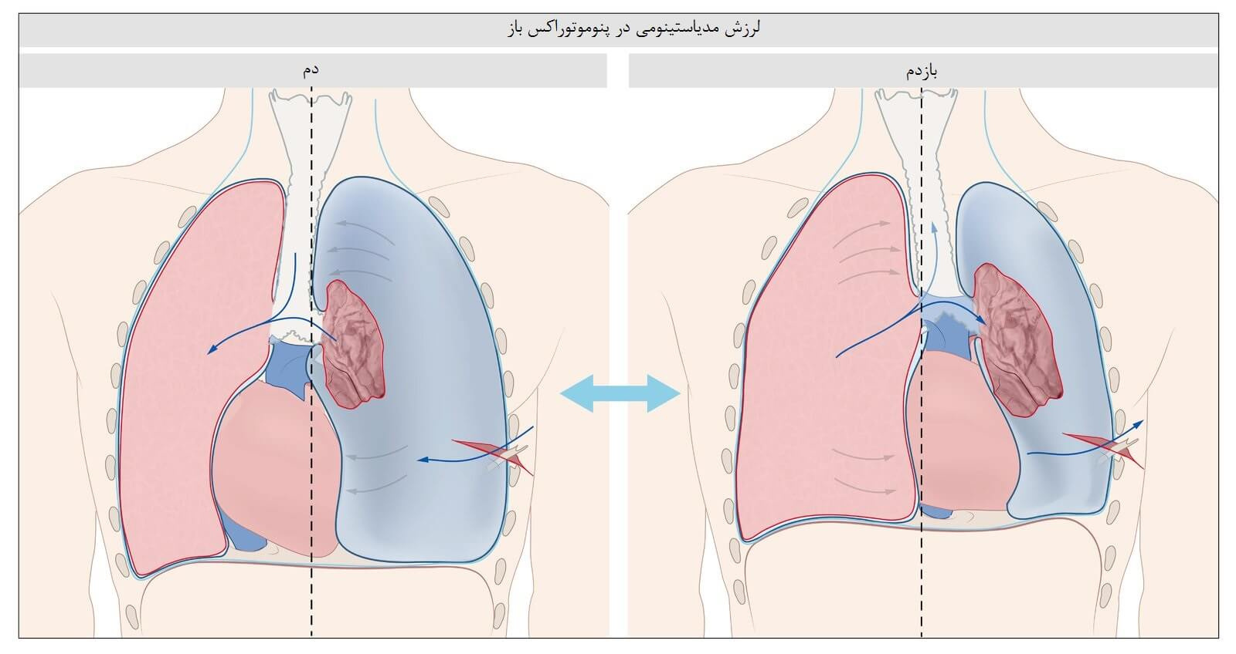
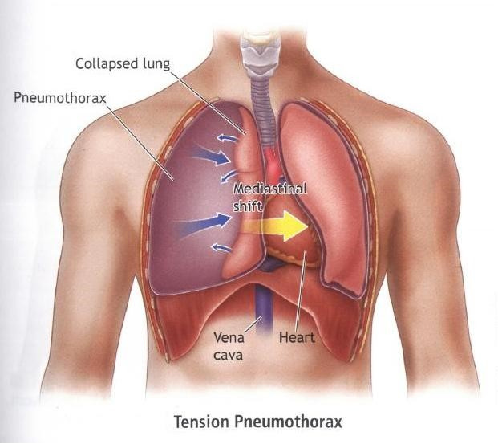

Slide 6
A CHEST TUBE CAN BE INSERTED TO EVACUATE AIR OR FLUID FROM THREE SPACES: RIGHT PLEURAL, LEFT PLEURAL, AND MEDIASTINAL.
12–14 Fr (Small size):
Used for simple pneumothorax or after video-assisted thoracoscopic surgery
28–32 Fr (Large size):
Used for severe hemothorax or empyema (purulent pleural effusion).
20–24 Fr (Medium size):
Suitable for mild hemothorax, pleural effusion, or pneumothorax with fluid drainage.
36–40 Fr (Very large size):
Commonly used in trauma cases for simultaneous evacuation of blood and air.

Slide 7
CHEST DRAINAGE SYSTEMS
TRADITIONAL CLOSED WATER-SEAL SYSTEM
WATER-SEAL SYSTEM WITH DRY SUCTION
DRY SUCTION SYSTEM
Uses suction to create negative pressure and enhance fluid drainage, typically set at 20 cmH₂O. A valve at the top of the suction chamber opens if pressure increases, allowing excess air to escape automatically. The water level in the sealed chamber reflects the negative pressure in the pleural space.
The chamber is filled with 2 cm of water but lacks a wet suction control system. It operates more quietly, but if the water-seal chamber is compromised, the system loses its effectiveness
Can be quickly deployed in emergencies, and the dry suction control remains functional even if damaged. It is often used for outpatient care or patient transport. However, its drawbacks include the lack of an air leak indicator and inability to detect pleural pressure changes.

Slide 8
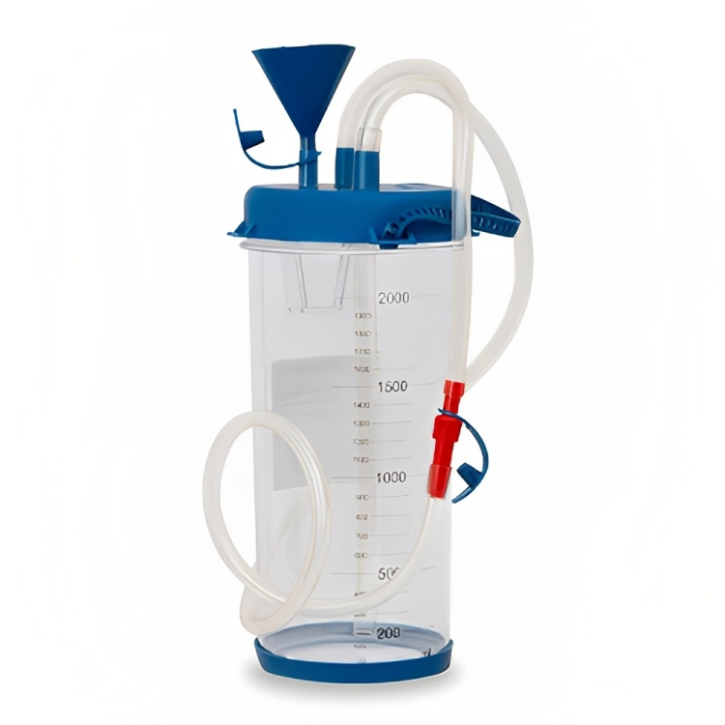
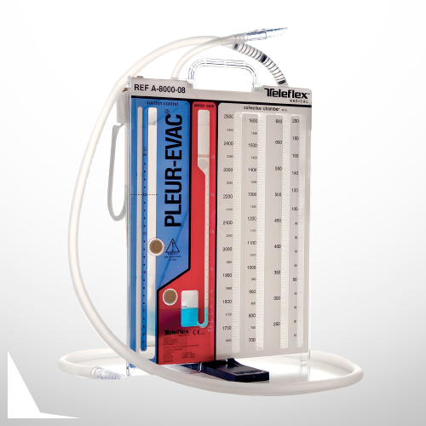
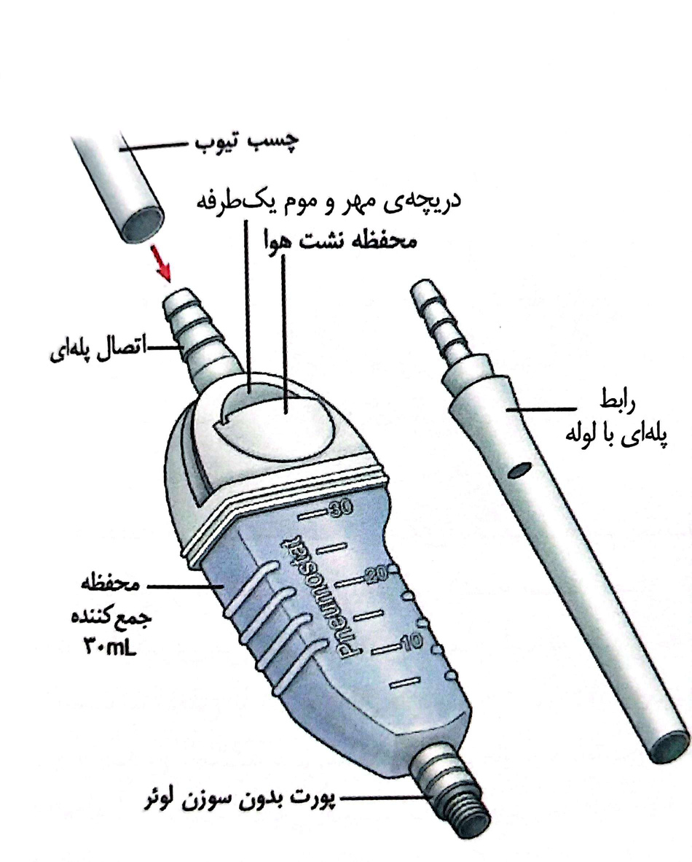

Slide 9
THANK YOU

