Slide 1
Acute kidney injury associated with Rhabdomyolysis after coronary artery bypass graft
Student: maedeh mohammadzadeh
Master:Mr.Ghaderi

Slide 2
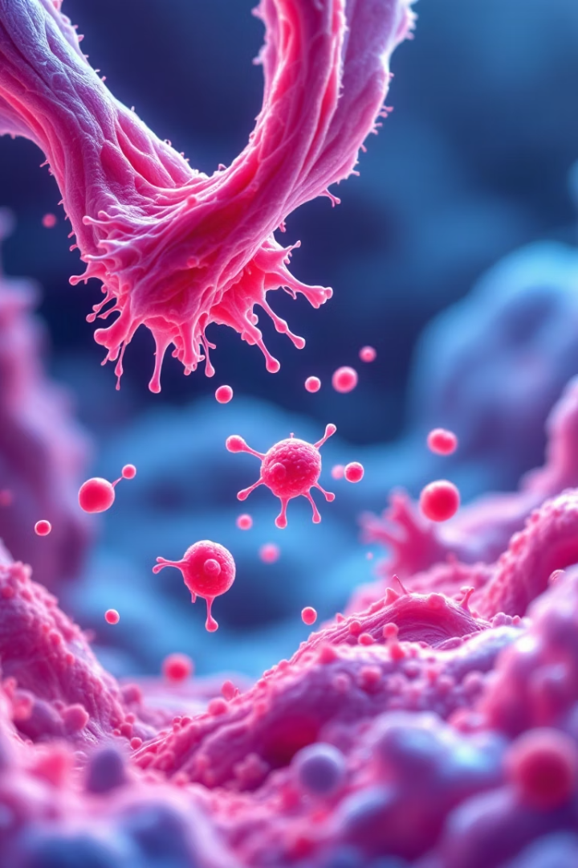
Rhabdomyolysis: When Muscles Break Down
Rhabdomyolysis is a serious medical condition that occurs when damaged muscle tissue breaks down rapidly, releasing proteins and electrolytes into the bloodstream. This breakdown can lead to severe complications including kidney failure and, in extreme cases, cardiac arrest.
Early recognition of symptoms and prompt medical intervention are crucial for preventing long-term damage. This presentation will explore the causes, symptoms, diagnosis, treatment options, and prevention strategies for this potentially life-threatening condition.

Slide 3








What Causes Muscle Breakdown?
Traumatic Injuries
Crush injuries, severe burns, electrical shock
Physical Factors
Extreme exercise, high temperatures, seizures
Chemical Influences
Medications, substance abuse, toxins
Medical Conditions
Infections, genetic disorders, metabolic issues
Rhabdomyolysis can occur in almost anyone under certain conditions. While athletes and physically active individuals face risks from overexertion, patients taking certain medications like statins may develop it as a side effect. Environmental factors such as extreme heat or prolonged immobility can also trigger this condition in otherwise healthy people.

Slide 4
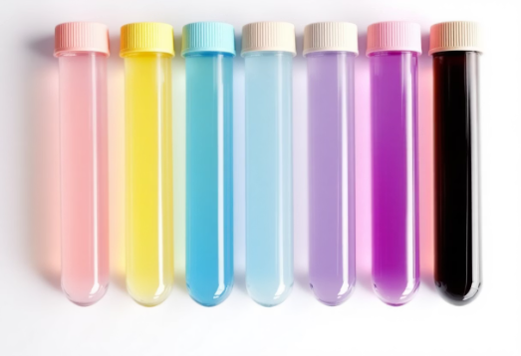
Recognizing the Warning Signs
Primary Symptoms
Diagnostic Markers
Severe muscle pain and weakness
Creatine Kinase >5× normal
Dark, tea-colored urine
Myoglobinuria
Muscle tenderness and stiffness
Positive dipstick for blood
Generalized fatigue
Electrolyte abnormalities
The distinctive dark urine is caused by myoglobin, a muscle protein that is toxic to kidneys when present in high concentrations.
Many patients initially mistake rhabdomyolysis symptoms for normal post-exercise soreness or flu-like illness, which can delay crucial treatment. The triad of muscle pain, weakness, and dark urine should prompt immediate medical attention, especially following intense physical activity or when taking medications known to affect muscle tissue.

Slide 5





Lifesaving Treatment Approaches
Aggressive Fluid Therapy
Intravenous fluids at 1.5× maintenance rate to flush myoglobin from kidneys
Electrolyte Correction
Careful monitoring and management of potassium, calcium, and phosphorus levels
Kidney Protection
Sodium bicarbonate administration to alkalinize urine and prevent tubular damage
Renal Replacement
Dialysis if acute kidney injury progresses despite conservative management
Early and aggressive intervention is the cornerstone of successful rhabdomyolysis treatment. The primary goal is to prevent acute kidney injury by maintaining high urine output through intravenous fluid administration. Most patients require hospitalization with continuous monitoring of kidney function, electrolytes, and acid-base balance.

Slide 6
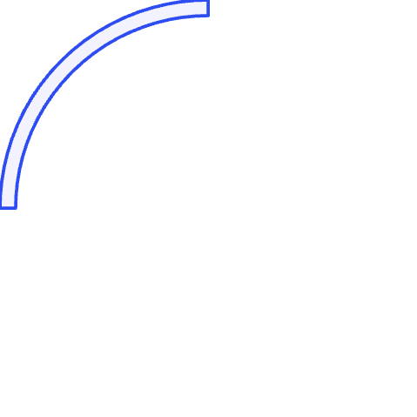







Preventing Complications and Recurrence
Kidney Injury
Cardiac Issues
Most common serious complication, occurring in up to 40% of cases
Arrhythmias from electrolyte disturbances, particularly hyperkalemia
Compartment Syndrome
DIC
Dangerous pressure buildup in muscle compartments requiring surgical intervention
Disseminated intravascular coagulation affecting blood clotting mechanisms
Prevention strategies focus on modifiable risk factors. For athletes and active individuals, proper hydration before, during, and after exercise is essential. Gradual progression in training intensity helps prevent overexertion-related cases. Patients on medications with rhabdomyolysis as a potential side effect should be educated about warning signs and monitored regularly.
Those with a history of rhabdomyolysis may require personalized prevention plans, including exercise modifications and increased vigilance during illness or extreme weather conditions.

Slide 7
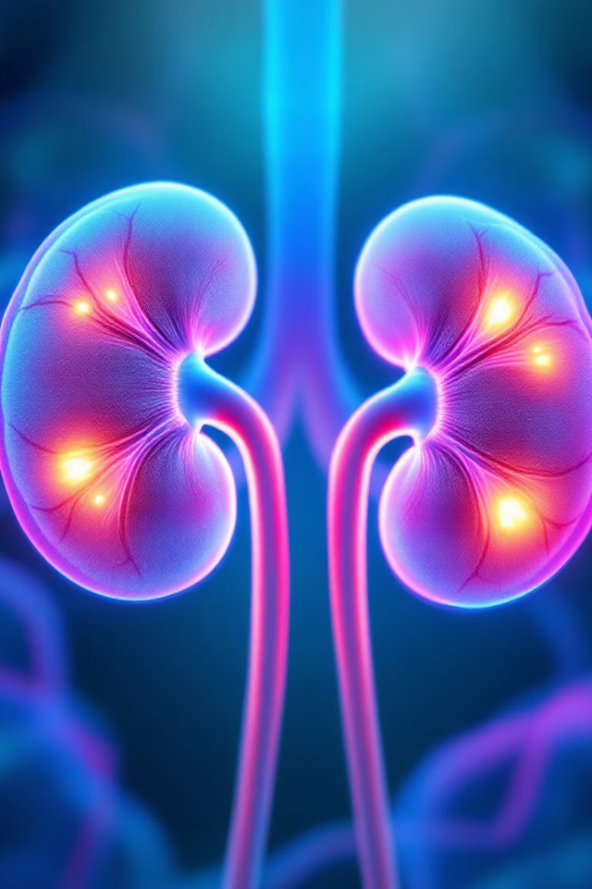
Acute Kidney Injury (AKI): Understanding the Crisis
Acute Kidney Injury represents a sudden, often dramatic decline in kidney function that affects 1-7% of hospitalized patients worldwide. This condition is identified through elevated serum creatinine levels or reduced urine output, signaling that the kidneys are struggling to perform their vital filtration duties.
More than just a temporary setback, AKI is associated with significant morbidity and mortality rates, particularly in intensive care settings. The economic burden is substantial, with extended hospital stays and complex interventions driving healthcare costs higher for both patients and health systems.
This presentation explores the causes, diagnosis, treatment options, and long-term implications of this serious medical condition.

Slide 8



Causes and Risk Factors
Acute Kidney Injury originates from three primary mechanisms, each affecting different anatomical segments of the renal system. Understanding these pathways is crucial for proper diagnosis and targeted treatment.
Prerenal Causes
Results from decreased blood flow to kidneys, including hypovolemia from blood loss, severe dehydration, hypotension, or decreased cardiac output in heart failure.
Intrinsic Causes
Direct damage to kidney tissue from conditions like glomerulonephritis, acute tubular necrosis, or toxic injury from medications and contrast agents.
Postrenal Causes
Urinary tract obstruction from kidney stones, tumors, strictures, or prostatic hyperplasia, preventing normal urine outflow.
Sepsis remains the leading cause of AKI in critically ill patients, contributing to nearly 50% of cases. Risk factors that predispose patients include diabetes, hypertension, existing chronic kidney disease, advanced age, and certain medications.

Slide 9






Diagnosis and Staging
Accurate diagnosis of Acute Kidney Injury relies on laboratory values, urine output measurements, and clinical evaluation. Early detection allows for prompt intervention and potentially better outcomes.
Serum creatinine remains the gold standard biomarker for AKI detection, though it has limitations as a late indicator of injury. Urine output patterns provide valuable real-time information about kidney function, with oliguria or anuria often signaling significant damage.
Stage 3 (Severe)
Creatinine ≥3.0× baseline or <0.3 mL/kg/h for >24h
Stage 2 (Moderate)
Creatinine 2.0-2.9× baseline or <0.5 mL/kg/h for >12h
Stage 1 (Mild)
Creatinine 1.5-1.9× baseline or <0.5 mL/kg/h for 6-12h
Emerging biomarkers like NGAL, KIM-1, and Cystatin C offer promise for earlier detection of kidney injury, potentially allowing intervention before significant damage occurs. These novel markers may supplement traditional criteria in the future.

Slide 10
Treatment and Management
The cornerstone of AKI management is identifying and addressing the underlying cause while supporting kidney function. Treatment strategies must be personalized based on the etiology, severity, and patient comorbidities.
Consider Renal Replacement Therapy
Medication Review and Adjustment
Optimize Hemodynamics and Fluid Status
Initiate dialysis or continuous renal replacement therapy when indicated by severe acidosis, hyperkalemia, uremic symptoms, or refractory fluid overload.
Identify and Treat Underlying Cause
Eliminate nephrotoxic drugs when possible and adjust medication dosages according to current kidney function to prevent further injury.
Carefully manage fluid balance with appropriate volume resuscitation for hypovolemia or diuretics for fluid overload. Monitor central venous pressure and urine output to guide therapy.
Promptly address sepsis with antibiotics, relieve obstructions, discontinue nephrotoxic agents, and treat other primary conditions contributing to kidney injury.
Nutritional support plays a vital role in recovery, with adequate caloric intake balanced against protein restrictions in non-dialysis patients. Regular reassessment of kidney function guides ongoing management decisions.

Slide 11
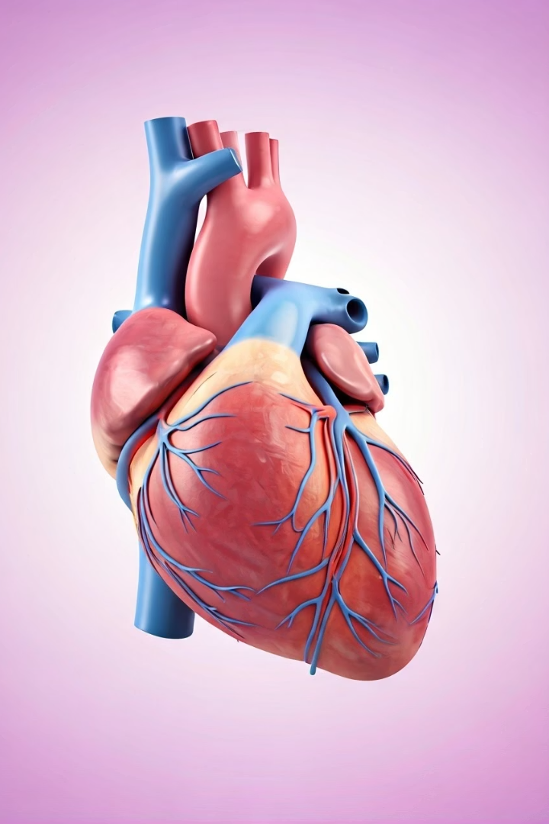
Coronary Artery Bypass Grafting: On-Pump vs. Off-Pump Techniques
CABG remains the gold standard treatment for severe coronary artery disease. Surgeons can choose between two primary approaches.
On-pump uses cardiopulmonary bypass while off-pump operates on a beating heart. Each technique offers unique benefits and risks.

Slide 12
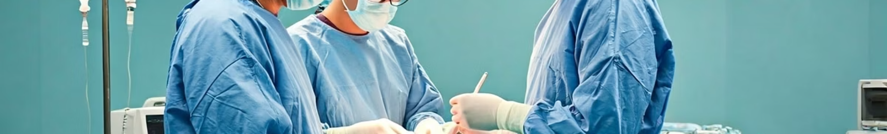




On-Pump CABG: The Traditional Approach
Patient Connection
Patient connected to cardiopulmonary bypass machine via cannulas.
Heart Stopped
Cardioplegia solution arrests heart, creating motionless surgical field.
Machine Function
CPB oxygenates blood and maintains circulation throughout body.
Graft Placement
Surgeon places grafts with precision on still heart.

Slide 13
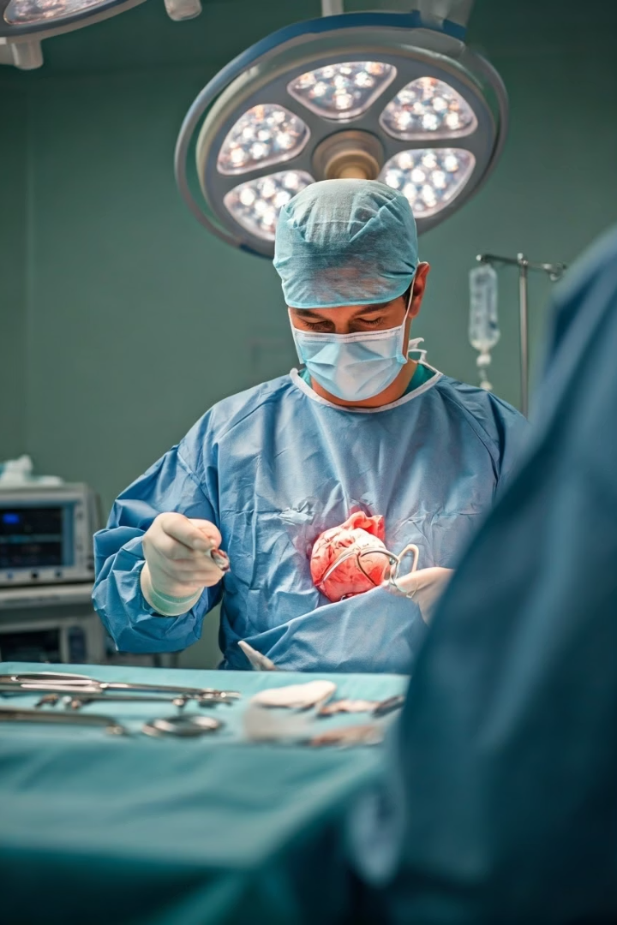



Off-Pump CABG: A Minimally Invasive Alternative
Beating Heart
Stabilization Devices
Smaller Incisions
Surgery performed while heart continues beating, no CPB required.
Less invasive approach results in smaller chest incisions.
Specialized tools immobilize specific coronary artery segments.

Slide 14
Benefits and Risks Comparison
On-Pump Benefits
On-Pump Risks
Off-Pump Benefits
Off-Pump Risks
Motionless surgical field
Increased stroke risk
Reduced CPB complications
Technically challenging
Complete revascularization
Kidney injury potential
Incomplete revascularization
Systemic inflammation
Shorter hospital stays
Established protocols
Less blood transfusions
Steeper learning curve

Slide 15
Thanks for your attention

