Slide 1
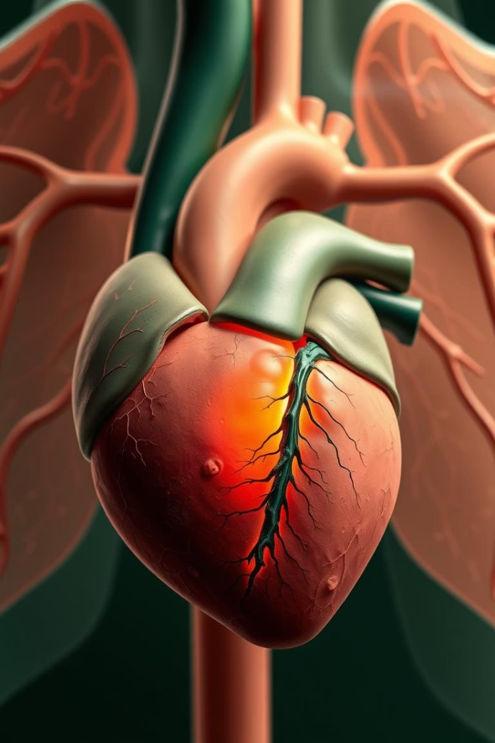
Cor Pulmonale: A Comprehensive Overview
Understanding cor pulmonale is essential for managing right heart failure due to lung disorders. This presentation covers causes, symptoms, diagnosis, treatment, and lifestyle guidance.
DD
Mohadese Daneshyar
Tutor: Mr. Rasouli

Slide 2
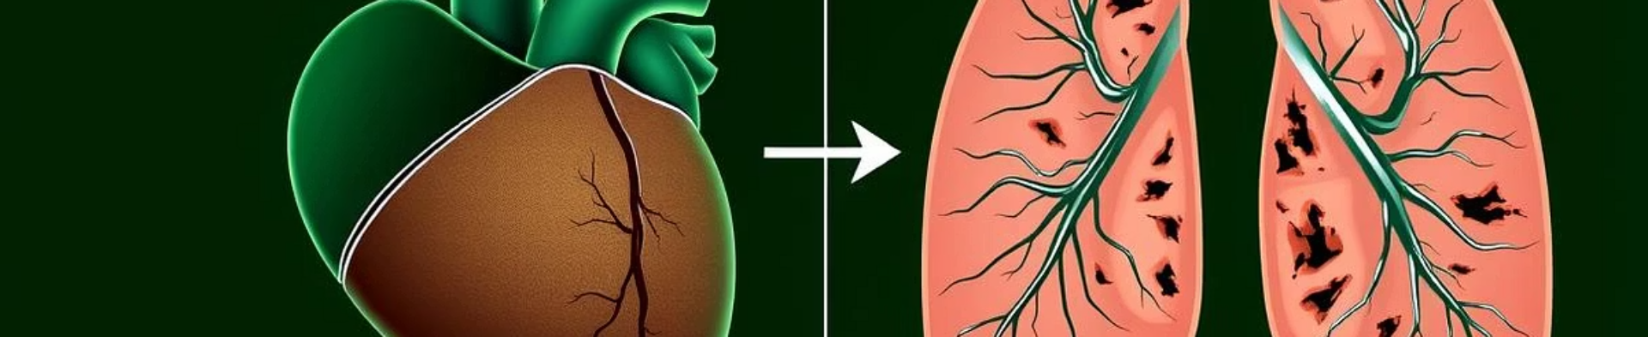
What is Cor Pulmonale? Defining the Condition and its Impact
Definition
Impact
Prevalence
Altered function amd structure of the right ventricle of the heart due to respiratory disease
Leads to impaired cardiac function.
Common in chronic respiratory conditions, especially in advanced stages.

Slide 3
Causes of Cor Pulmonale: Exploring Underlying Respiratory Diseases
Chronic Obstructive Pulmonary Disease (COPD)
Restrictive Lung Disease
Other Causes
Includes idiopathic pulmonary fibrosis reducing lung compliance and oxygen exchange.
Includes pulmonary embolism and sleep apnea, pulmonary hypertension, and pickwickian syndrome.
The leading cause, including chronic obstructive bronchitis and emphysema.

Slide 4

Pathophysiology: How Lung Disease Leads to Right Heart Failure
1
Chronic Hypoxia
Leads to pulmonary vasoconstriction and increased vascular resistance.
2
Pulmonary Hypertension
Elevated pressure causes the right ventricle to work harder.
3
Right Ventricular Hypertrophy
The heart muscle thickens, initially compensating for the strain.
4
Right Heart Failure
Eventually, the ventricle dilates and fails, leading to symptoms.

Slide 5
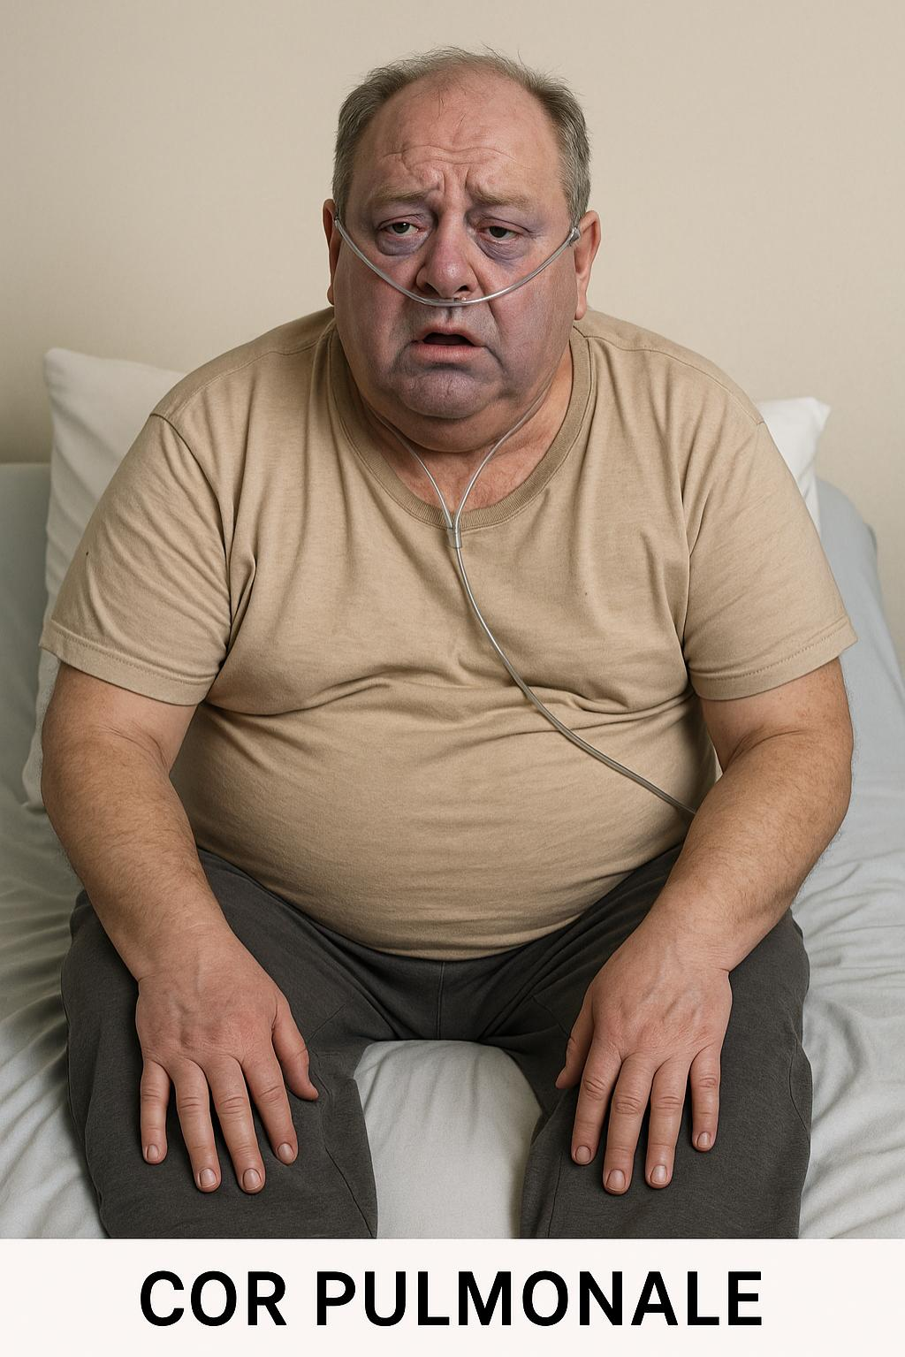
Symptoms and Clinical Presentation: Recognizing the Signs
Common Symptoms
Signs
Dyspnea, fatigue, chest discomfort, and palpitations.
Jugular venous distension, peripheral edema, and cyanosis.
Advanced Presentation
Ascites and hepatomegaly indicating right-sided heart failure.

Slide 6

Diagnostic Evaluation: Tests to Confirm Cor Pulmonale
Echocardiography
Chest Imaging
Visualizes right ventricle size and function, detects pulmonary pressure.
Chest X-ray or CT identifies lung disease and vascular changes.

Slide 7




Treatment Strategies: Addressing the Root Cause and Managing Symptoms
Oxygen Therapy
Corrects hypoxia and reduces pulmonary vasoconstriction.
Medications
Diuretics, vasodilators, digitals, and anticoagulants as needed.
Treat Underlying Lung Disease
Manage COPD or other respiratory illnesses aggressively.

Slide 8

Nursing diagnosis
Impaired gas exchange related to ventilation /perfusion mismatch
Decreased cardiac output related to right ventricular failure
Excess fluid volume related to heart failure and fluid retention
Activity intolerance related to imbalance between the oxygen demand and supply
Anxiety related to breathlessness and uncertain prognosis

