Slide 1
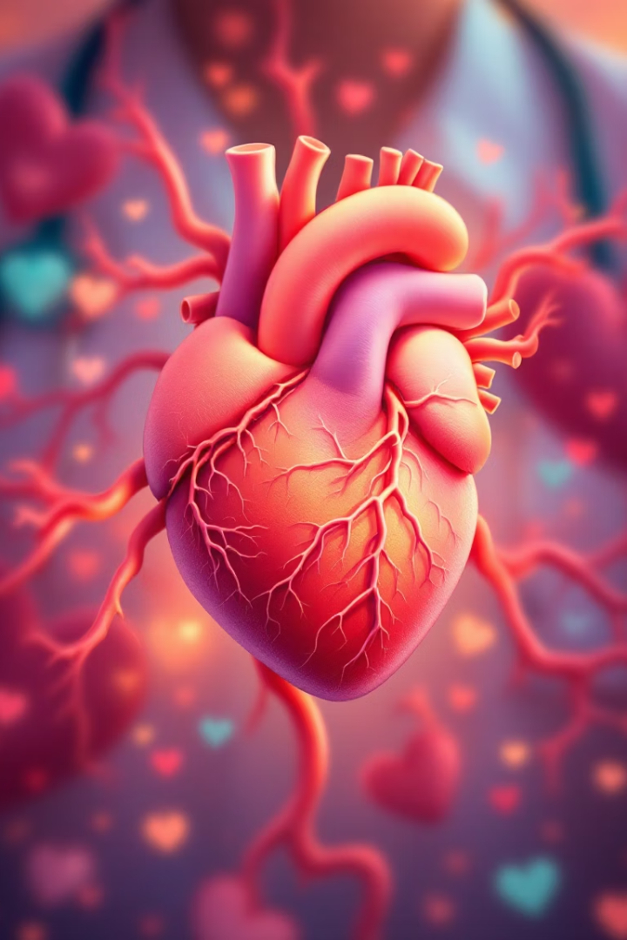
Coronary Artery Disease
Presented by Dehghan
Master: Mr.Ghaderi

Slide 2

About Coronary Artery Disease
Definition
Types
Coronary artery disease (CAD) involves narrowing of heart arteries.
Main two types: stable angina and acute coronary syndrome.

Slide 3
Risk Factors for Coronary Artery Disease
Modifiable Risks
Non-Modifiable Risks
High LDL cholesterol over 130 mg/dL
Age: men over 45, women over 55
High blood pressure above 130/80 mmHg
Male gender higher risk
Diabetes with fasting glucose over 126 mg/dL
Family history before age 55
Smoking doubles to quadruples risk
Obesity with BMI over 30
Physical inactivity less than 150 min/week

Slide 4

Signs and Symptoms of CAD
Chest Pain (Angina)
Other Symptoms
Heart Attack Signs
Pressure or burning in chest, worsened by exertion or stress.
Shortness of breath
Severe chest pain, sweating, nausea, and vomiting.
Fatigue and weakness
Severe cases lead to heart attack

Slide 5

Diagnostic Methods Part 1
Stress Test
Electrocardiogram (ECG)
Monitors ECG during exercise to assess blood flow under stress.
Records electrical heart activity; detects arrhythmias and heart damage.
Sensitivity 68%
Specificity 77%

Slide 6




Diagnostic Methods Part 2
Coronary Angiography
X-ray imaging with contrast; gold standard for CAD detection.
Pinpoints location and severity of blockages.
CT Angiography
3D CT scans with contrast; less invasive alternative.
Nuclear Stress Test
Sensitivity 85%, specificity 75% using radioactive tracers.

Slide 7
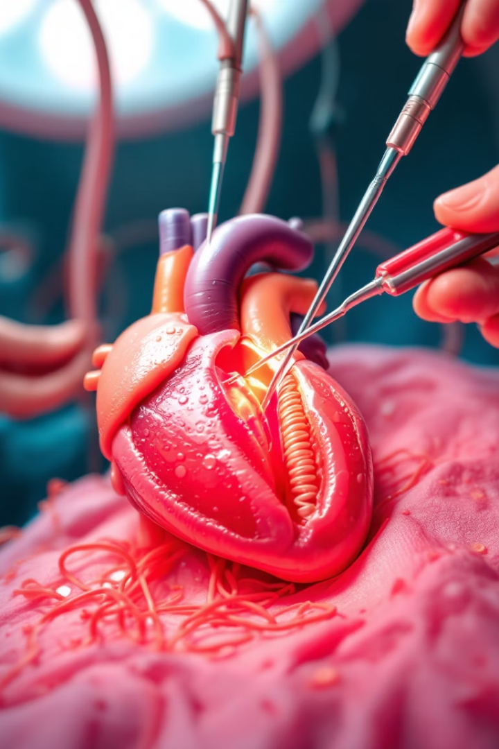
Treatment: Angioplasty
Angioplasty (PCI)
Uses a balloon to open narrowed arteries and insert a stent.
Success Rate
90-95% effective with 5-10% chance of restenosis in drug-eluting stents.

Slide 8
Treatment: Coronary Bypass Surgery
CABG Procedure
Survival Rates
Grafts healthy vessels to bypass blocked arteries.
5-year survival: 85-90%
Used mainly in severe CAD cases.
10-year survival: 70-80%

Slide 9

Prevention of Coronary Artery Disease
Healthy Lifestyle
Balanced diet low in fat and salt
At least 150 minutes of exercise weekly
Quit smoking and manage stress
Maintain healthy weight
Risk Management
Regular blood pressure and cholesterol checks
Effective diabetes control

Slide 10


Slide 11

Thank You for Your Attention
We appreciate your time and interest in coronary artery disease knowledge.

