Slide 1
In the name of god
Pheochromocytoma
Presented by: Erfan Poorhang
Advisor: Dr. Raisi

Slide 2
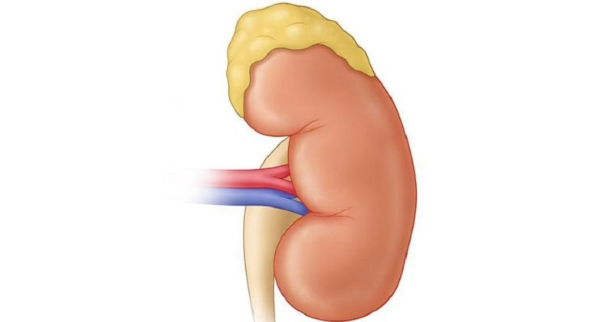
Introduction
Epinephrine
Norepinephrine

Slide 3
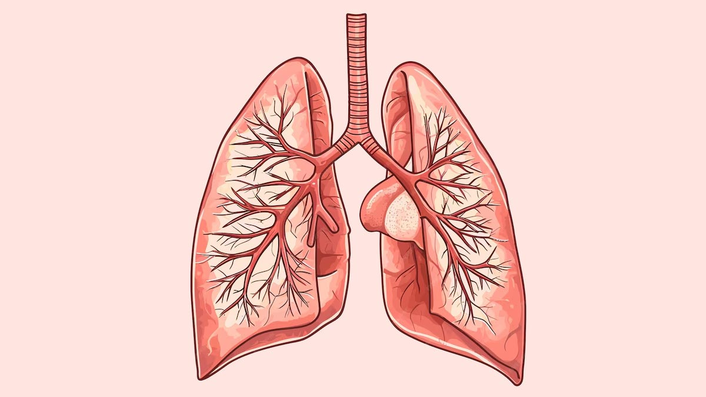
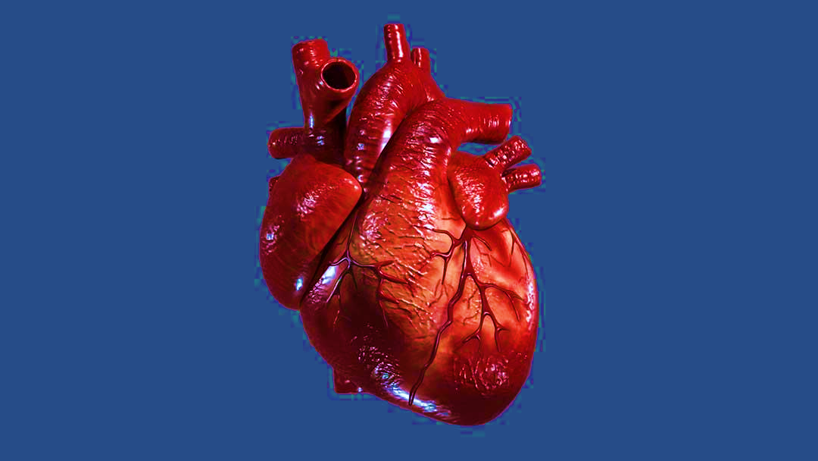
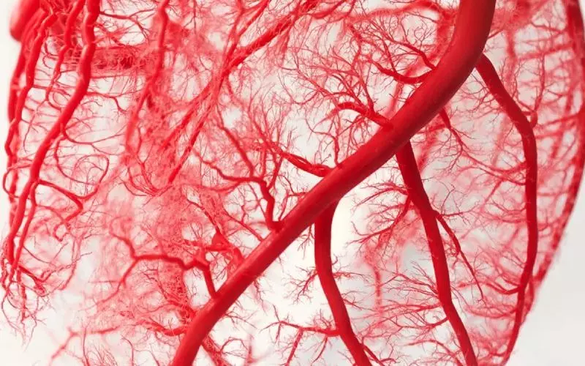

Adrenergic receptors
α receptors
β receptors
β2
β1
α1

Slide 4

Uses of epinephrine
Cardiac arrest: VT, VF, Asystole, PEA
Anaphylaxis
Hemorrhage
Croup syndrome

Slide 5
Epinephrine dosage forms
Ampoule:
1:1000 1mg/1cc anaphylaxis
1:10000 0.1mg/1cc cardiac arrest
In CPR
1/10000
0.1 mg every three to five minutes
IV slow
In anaphylaxis
1/1000
0.3 to 0.05 mg
IM

Slide 6
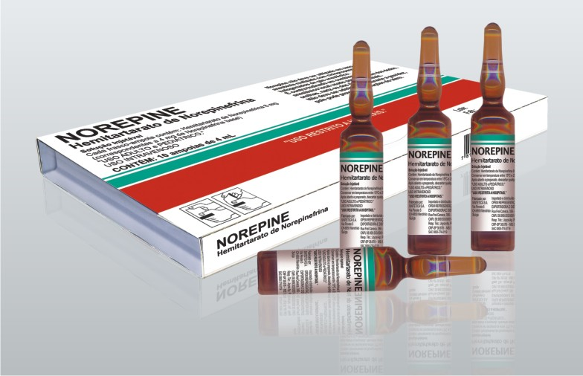
Uses of norepinephrine
Hypotension
Shock
Therapeutic dose:
0.1-0.5 μg/kg/min
Ampoule :
1 mg /10 cc

Slide 7

Nursing measures:
Cardiac monitoring
Vital signs control
Blood pressure control
Prohibited in myocardial infarction
Prohibited in hemorrhagic CVA

Slide 8
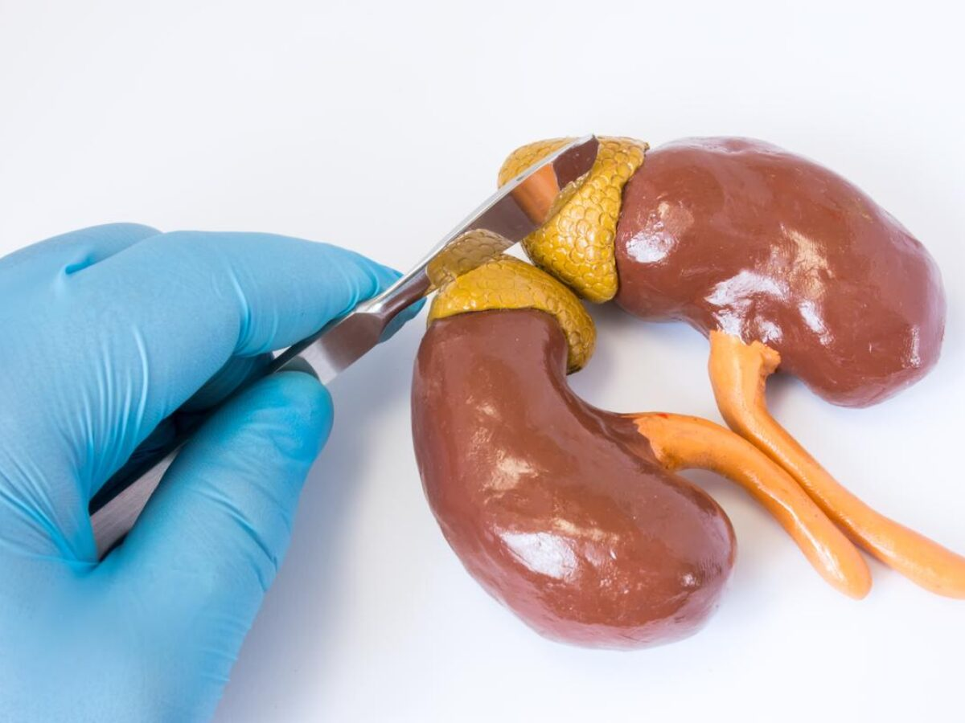
Pheochromocytoma
Pathology
Clinical manifestations
Treatment

Slide 9
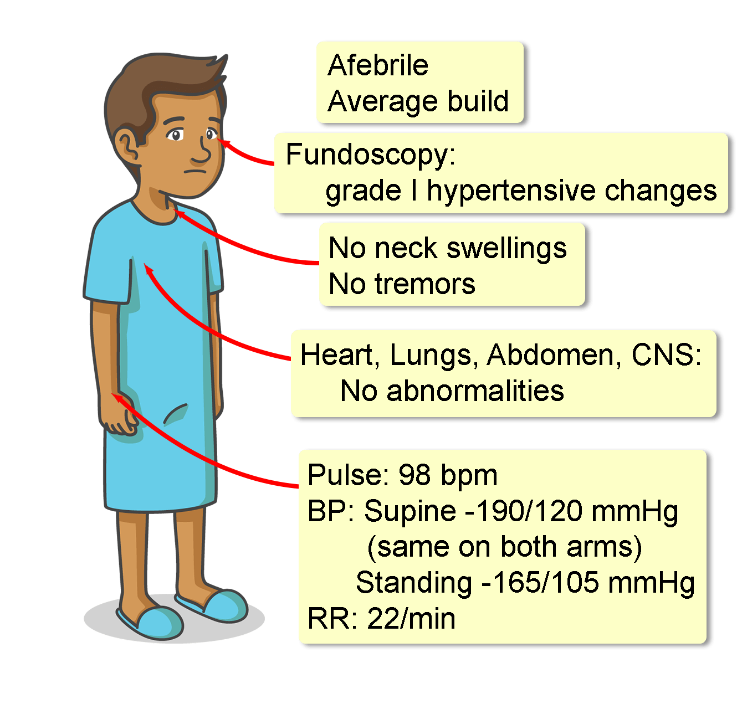

Slide 10

Thank you for your attention

